Slide 1
Cartpole Controller Tuning

Slide 2
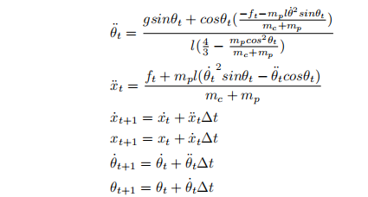
Carptpole Model

Slide 3
Carptpole Modes
Variations in pole length.
Variations in mass of the cart.
Friction between the pole and the cart.
Friction between the cart and the track.

Slide 4
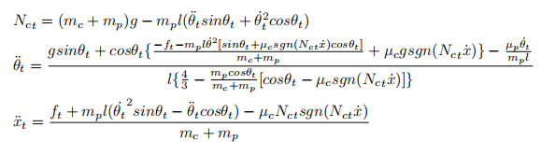
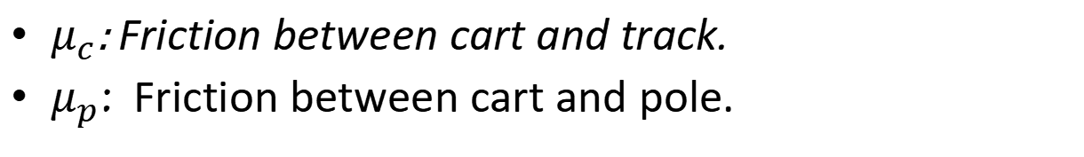
Carptpole Model. Adding friction.
$μ_{c}$: Friction between cart and track.
$μ_{p}$: Friction between cart and pole.

Slide 5
Input/Output/Loss
Inputs: Force magnitude and direction. (Continuous, bounded, scalar).
Outputs:
Cart position.
Pole angle.
Cart speed in the horizontal axis.
Pole angular speed.
Cart acceleration (??)
Pole angular acceleration (??)
Loss:
Reward: r(s) = 1 − 0.08681x²− 0.00347θ²

Slide 6
Operating mode ranges
Length of the pole.
Mass of the cart.
Friction between pole and cart: [0; 0.01].
Friction between cart and track: [0; 0.8].

Slide 7
Control
PID
Pole angle
Bounded Force

Slide 8
Stable Control Region Generation.
Stablish nominal plant parameter values.
Sweep plant parameters (linearly spaced parameter values within parameter range) independently (only one operating condition at a time).
Tune controller for each configuration (fixed initial conditions).
Metaheuristic search.
Ziegler-Nichols tuning.
Produce stable control region using Monte Carlo simulations (randomize initial conditions).
Log loss values for all domain/control combinations.

Slide 9
Stable Control Region Generation.
Determine controllable plant parameter ranges.
Select minimum control set for each mode.
Explore mode combinations (more than one parameter deviates from nominal value simultaneously).

